Slide 1
Webonise Lab
Induction Program
OOP

Slide 2
Software
Software is a collection of Objects interacting with each other based on the relationships between them.

Slide 3
The OO and Procedural paradigm
In procedural programming, functions are defined independently from the data structures (classes), and must be explicitly passed the data they are to work with.
In OOP, functions are defined in the context of data (Objects), encapsulated by classes; such functions are usually called methods.

Slide 4
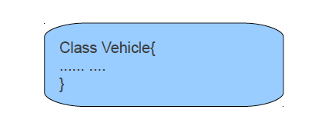
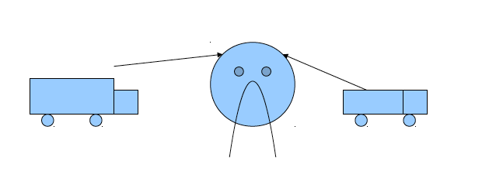
Creating Objects

Slide 5
Mapping Relationships
Multiplicity:
One to one – ‘Holds’ relationship between an Employee and a Position
One to Many – ‘Works In’ relationship between an Employee and a division
Many to Many – ‘assigned’ relationship between Employee and Task
Direction:
Uni – directional – ‘Holds’ relationship between an Employee and a Position
Bi – directional – ‘Works In’ relationship between an Employee and a division

Slide 6
Implementing Relationships
Relationships in object schemas are implemented by a combination of
references to objects and operations.
Multiplicity is one (e.g. 0..1 or 1) - a reference to an object, a getter operation, and a setter operation.
Multiplicity is many (e.g. N, 0..*, 1..*) - via a collection attribute, such as an Array, and operations to manipulate that array.
Uni-directional - the code is implemented only by the object that knows about the other object(s).
Bi-directional – the code is implemented by both the objects involved.

Slide 7
Thought Process
Coupling – the degree to which a module (class) depends on other classes.
Cohesion – is the measure within a module (class) of how well the members work together to provide a specific piece of functionality.

Slide 8
Thought Process
Single responsibility principle - a class should have only a single responsibility.
Open/closed principle - “software entities … should be open for extension, but closed for modification”.
Liskov substitution principle - “objects in a program should be replaceable
with instances of their subtypes without altering the correctness of that program”.
Interface segregation principle - “many client-specific interfaces are better than one general-purpose interface.”
Dependency inversion principle - one should “Depend upon Abstractions. Do not depend upon concretions.”

Slide 9
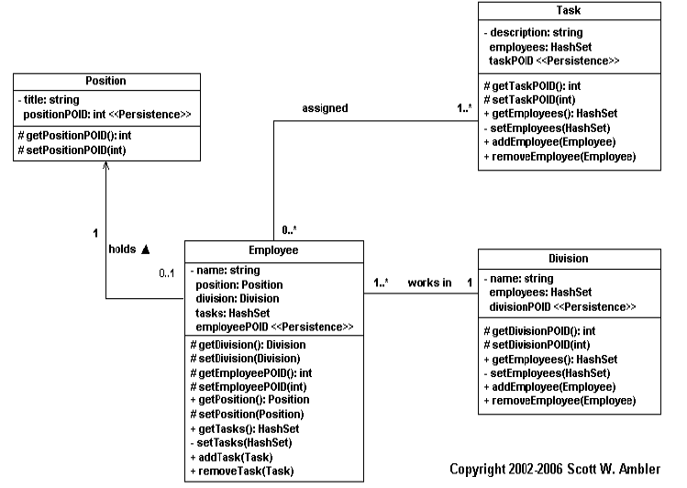
Example

Slide 10
Assignment
Build a Virtual College…

Slide 11
Thank You

